Slide 1
Mileage and expenses
Notes:
Desire to reimburse any costs incurred whilst doing your role but at the same time stewarding the money that has been donated to us to support families to honour them and those who financially support us. We also need to be able to stand up to the scrutiny of a financial audit so need to evidence that the expenses occurred are all in line with Safe Families aims and are fully accountable.

Slide 2
How to approve
Two routes to approve a mileage or an expense claim:
Direct link will be sent to you once the submit button is pressed
OR
Log into the staff database and at the top of the dashboard any pending requests will be listed

Slide 3
How to approve

Slide 4
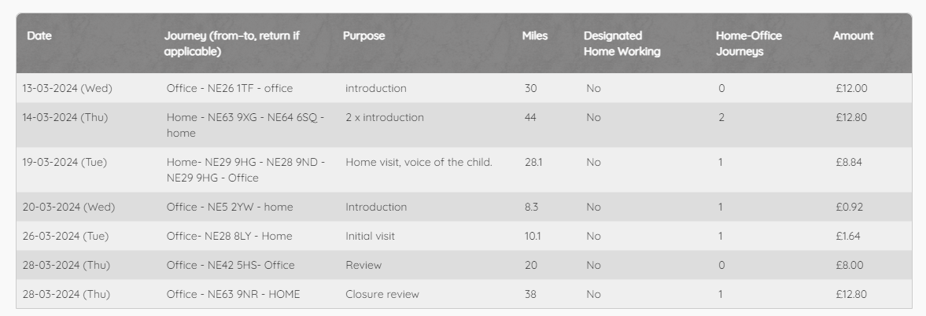
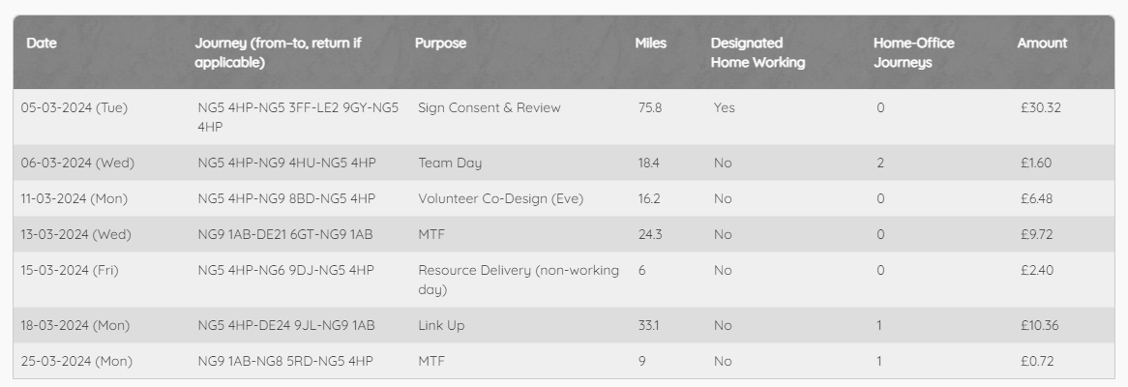
Mileage
Agreed designated home working days put on staff profile
Check against diary
Clarity of the journey description – Home or Office instead of postcode, “(eve)” when in evening to help finance check

Slide 5
Mileage
Agreed designated home working days put on staff profile
Check against diary
Clarity of the journey description – Home or Office instead of postcode, “(eve)” when in evening to help finance check
Home-Office journeys
Weekends and evenings

Slide 6
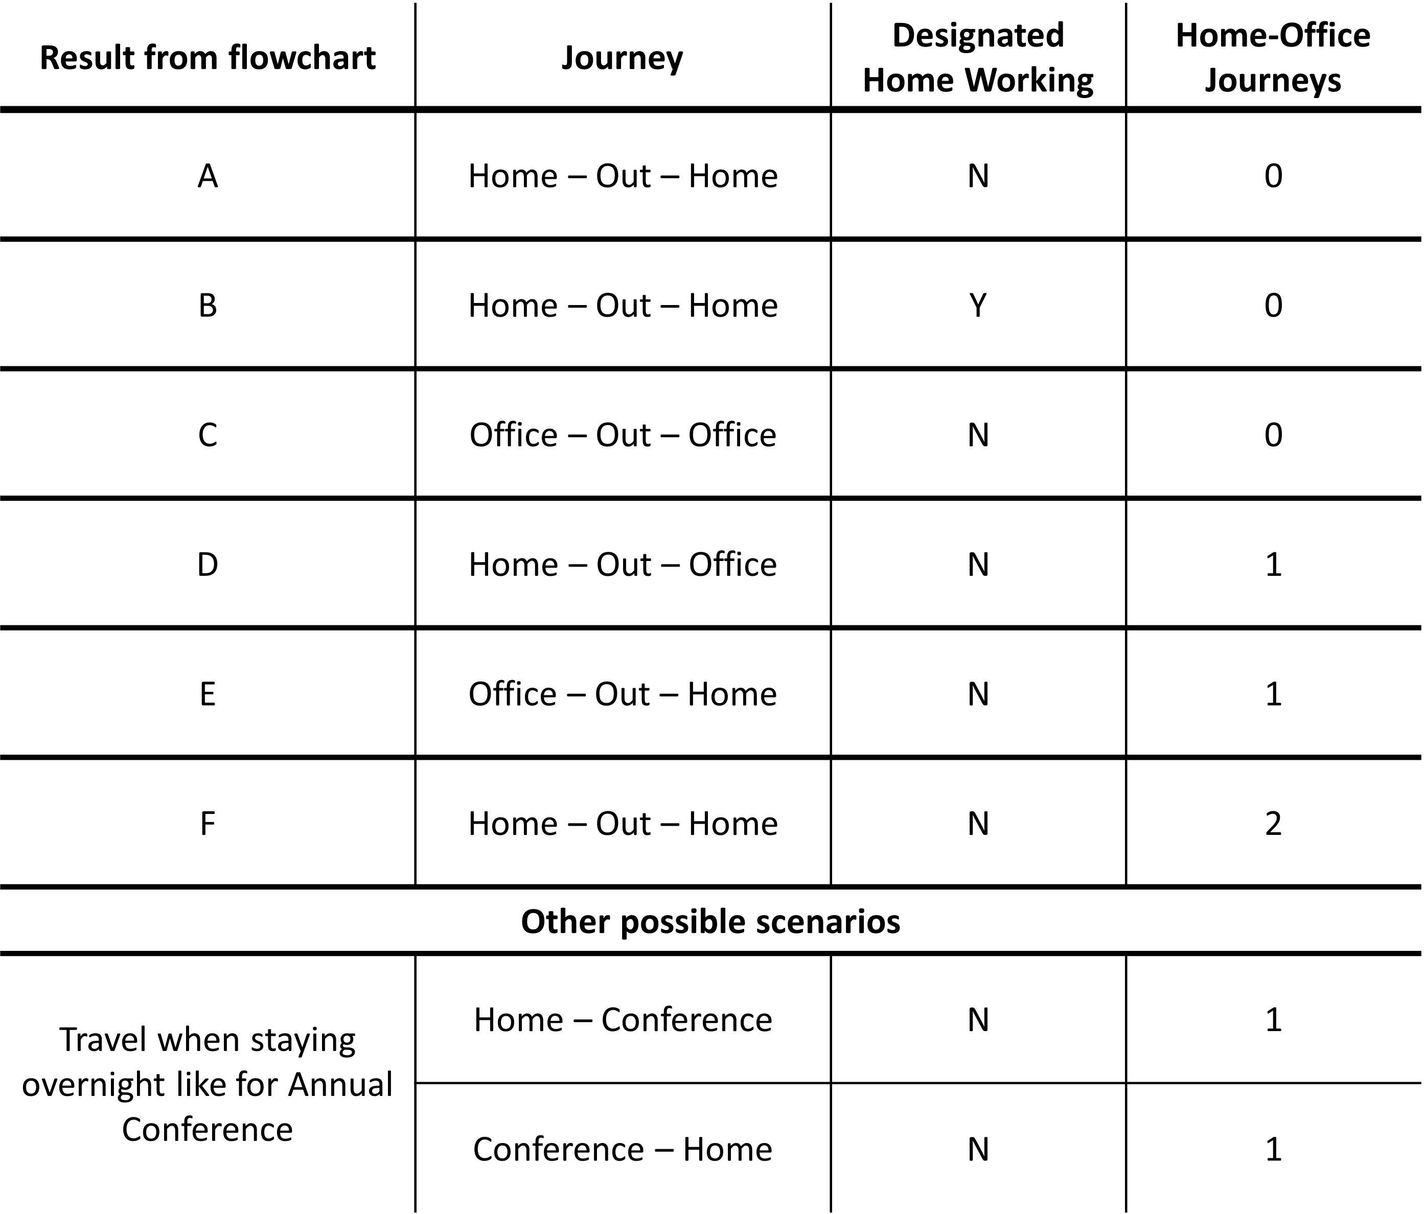

Slide 7
Expenses
Date = date of purchase
Travel – put date of purchase not date of travel
Inline with expenses policy – some items can’t claim for, suggested limits (can go over but would be helpful to know approved with acknowledgement of limits)
Items that can’t be expensed:
Alcohol
Staff birthday or leaving gifts
Filter coffee
SUBSISTENCE | UPPER LIMIT GUIDANCE
Breakfast (with drinks) | £7.50
Lunch (with drinks) | £10.00
Dinner (with drinks) | £20.00
Overnight Accommodation Inner London Outside of London | £150 per night £110 per night

Slide 8
Expenses
Best practice
How many people drinks in café were for
ID for family when buying resources
Use the comments boxes to explain anything that is unclear or has been discussed relating to the claim like going over the suggested limit

Slide 9
Expenses
Receipts
Date, amount and item need to be clear – not too small, blurred, highlight items claiming for
Ideally itemised receipt, if only have card receipt – put in “Any comments?” box
Amazon – PDF invoice download
Email receipts – print to PDF and upload
Best practice – circle date, amount so make sure include in picture
Find it easier to check if all receipts in one document
Keep receipts till the claim has been paid

Slide 10
Receipts
Where items were bought
Amount
Items bought
Purchase date

Slide 11
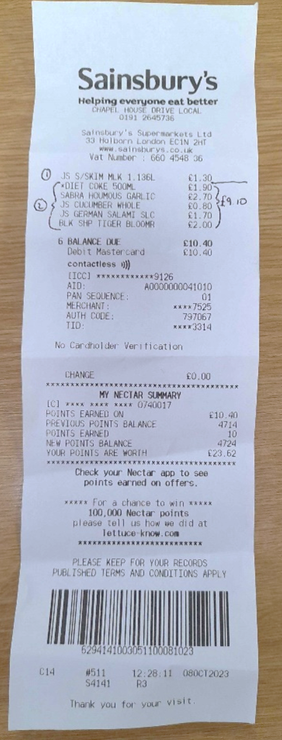
Receipts

Slide 12
Queries
If have a query about what the person has put…
Go to the person and ask them about it
If you have a query about policy…
Come to Ian or me

